Slide 1
Implementing Turtle Braille One Pixel at a Time Sampling Strategy
A tool to help the blind "see" simple graphics

Slide 2
Introduction
Presentation Goal
Demonstrate shadowing turtle module, adding features for the blind
Tool Goal
For the blind, access to simple graphics

Slide 3
Background
I'm a programmer / teacher
Graphics / Pictures are powerful
Blind have limited access to graphics

Slide 4
The Tool
Initial goal: Help beginners learn Programming
Extended goal: Simple graphics for Visually Impaired

Slide 5
Using just turtle - draw a square
# square_loop_colors_std.py
# Display a square different color each side
from turtle import * # Using standard library
width(40) # Widen square edges
colors = ["red","orange","yellow","green"]
for colr in colors:
color(colr) # Give side this color
forward(200)
right(90)
done() # Complete drawing
Notes:
Turtle Graphics a part of the Logo programming language
Developed by Wally Feurzeig, Seymour Papert and Cynthia Solomon in 1967 MIT
We don't like possible confusion by re-using turtle.py name.

Slide 6
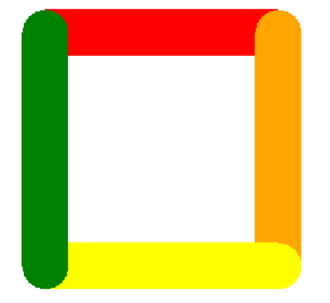
Using turtle – graphic output
Notes:
We don't like possible confusion by re-using turtle.py name.

Slide 7
Using tool - draw a square
# square_loop_colors_std.py
# Display a square different color each side
from turtle_braille_link import * # our code
width(40) # Widen square edges
colors = ["red","orange","yellow","green"]
for colr in colors:
color(colr) # Give side this color
forward(200)
right(90)
done() # Complete drawing
Notes:
We don't like possible confusion by re-using turtle.py name.

Slide 8
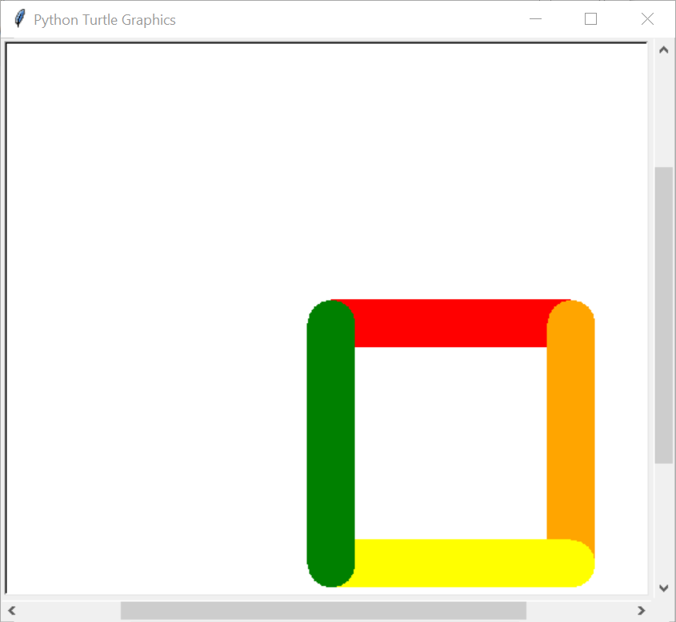
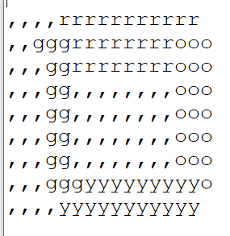
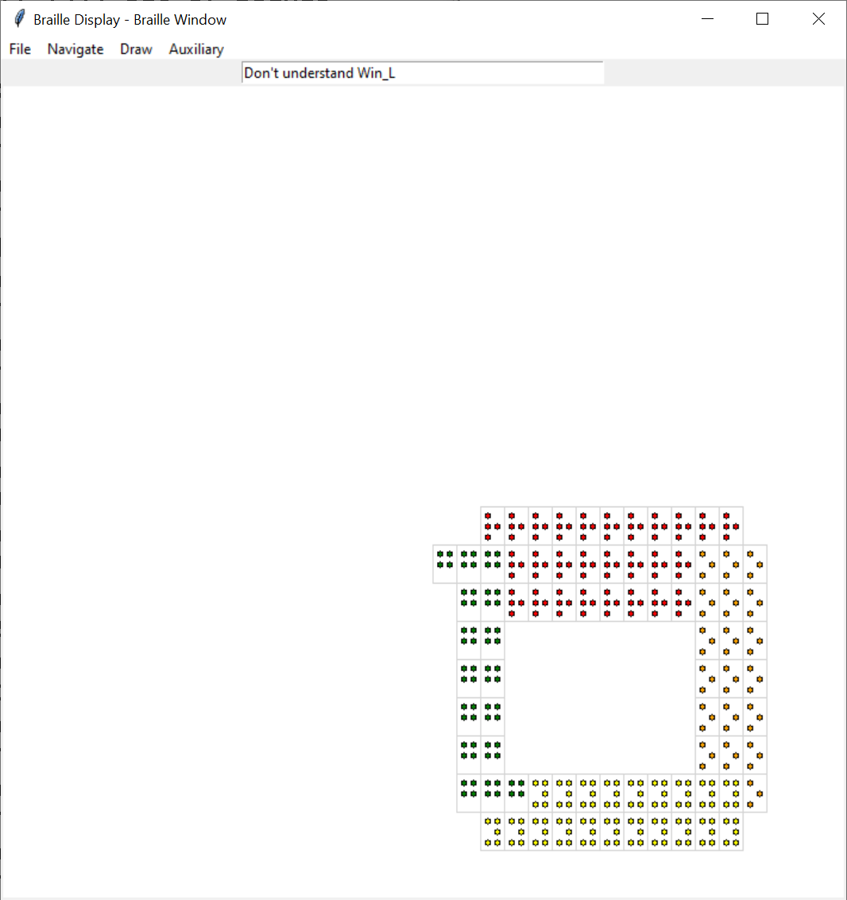
Tool Output → +Text picture, +Audio feedback
Notes:
Braille display widow started as a guide to the implementor
Became an audio based guide

Slide 9
The Plan
Braille rendition of simple Turtle graphics
A text picture to send to the embosser
Coarse – 40 characters by 25 lines
One color letter per square

Slide 10
The Plan continued…
Sample points for each visible graphic – e.g. line/rectangle
Create display cells from points

Slide 11
What are Shadow functions ?
Associated with each/most primary functions e.g. Turtle functions
Produce "extra" action/state
The "extra" supports our needs
displays, optimization, tracking
Notes:
Predates python

Slide 12
Our Turtle Shadow functions
Create/maintain state for our display(s)
for each Turtle function
Do action mirroring turtle action
Maintain state e.g. color, position

Slide 13
Shadow Function: goto()
def goto(self, x, y=None): rt = self.tu.goto(x,y) x1 = self.x y1 = self.y x2 = x if y is None: y = self.y y2 = y self.add_line(p1=(x1,y1), p2=(x2,y2)) return rt

Slide 14
Shadow function: add_line
def add_line(self, p1=None, p2=None, color=None, width=None): """ Add new line :p1: xy pair - beginning point default: previous point (add_point or add_line) :p2: xy pair - ending point default: previous point (add_point or add_line) :color: line color default: previous color ["black"] :width: line width default: previous width [1] """ if p1 is None: p1 = (self.x,self.y)
Notes:
OK – long bullets – read the bullets

Slide 15
Shadow function: add_line continued
if p2 is None: raise Exception("p2 is missing") if self.is_filling: self.add_to_fill(p1,p2) if width is None: width = self.line_width if color is None: color = self._color if self.is_pendown: points = self.get_drawn_line_points(p1, p2, width) self.populate_cells_from_points(points, color=color) self.x, self.y = p2
Notes:
OK – long bullets – read the bullets

Slide 16
Audio Feedback
Braille Picture was OK – but slow
Displays Braille picture with:
User navigation (cursor keys, mouse)
Speech description of location
Audio tones – faster yet response

Slide 17
Audio Feedback continued
Voice – uses pyttsx3 speech to text module
Tones – github: daviddavini/pysinewave
pysinewave_master – PYPI: not new enough
async, stereo
Added simple drawing facility

Slide 18
Alternate Strategy for Display Cells Road Not Taken
Scan resulting Tkinter Canvas object
Most Turtle calls unchanged
Simpler – few shadow functions
Supports non-turtle tkinter programs
Facilitates scale changes

Slide 19
Future Possibilities
Navigational Improvements
Speedups – async talking
Stereo audio feedback, distance, direction, feedback
More intelligent/automatic scanning
Presentation Improvements
Real-time scaling region magnification / selection

Slide 20
Lessons Learned / Relearned
No substitute for feedback
Users - recognize what they like
Developers - knows what can be done
Notes:
Multiple space conversion
Talk is slow – audio tones

Slide 21
Source Code
GitHub Project github.com/raysmith619/resource_lib
src/ – source files (all Python)
README.md – Short description
Alternate direction, with discussion
raysmith619/TurtleBraille

Slide 22
Question and Answer

